Slide 1

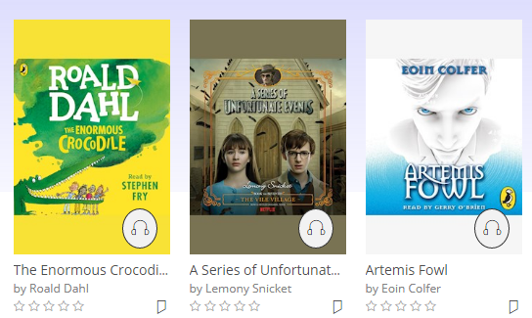

Reading at Eyemouth Primary P4-7
Here, at Eyemouth Primary, we understand the important role reading has in helping the children in our school achieve as much as possible. Reading regularly helps our children in many ways to develop skills and knowledge that will benefit them throughout their lives. This is why we actively encourage regular reading both in school and out.
What we do In school your child will be given daily opportunities to engage with texts. We aim to hear children reading aloud regularly, promote thinking about texts through questioning and learning activities and also provide targeted support wherever it is needed. Children are also given access to texts through a number of ways. The school has a well-stocked library of books, which is ever expanding. This includes fiction and non-fiction books, newspapers, comics and graphic novels. Children also have access to an online library. To access this search for the school website, click on the pupil dropdown (found at the top of the main page) and select the ‘reading logins and information’. From here, click on the link to the ‘online e-library’. Link to website-Eyemouth Primary School – Home Online library- To use the online library your child will have been provided with login details (contact your class teacher if you do not have this). This will give you access to the library and allow your child to borrow books. To help get the right choice of books there is a search tool that provides collections grouped in Accelerated Reading levels. To do this find the Accelerated Reading logo near the top of the main page and click of the ‘resources here’ link. The online library has over 1500 books to chose from!
Accelerated Reading Children in P4-7 use the accelerated reading programme which is used to track children’s progress in reading. Children carry out a quiz called STAR reader in school and their score is used to determine a range of books they can select from which are not too difficult, yet challenging. Your child’s recommended reading range will be provided in their reading record. At the end of each book children take a quiz about the book and the scores are collected to check the book has been understood. To help you choose books at the recommended level, you can use AR book finder. Search for ‘ar book finder’. Then select your role, type in the name of any book and the book level, if it is available on AR, will be given. https://www.arbookfind.co.uk/ Home learning As part of your child’s home learning we highly recommend regularly reading at home. As a starter we suggest a minimum of 3 reading sessions of approximately 20 minutes per week. It is also advisable that you hear your child reading aloud during one of these sessions, when possible. Reading records should be signed by an adult once a week, with a short note of the reading added each time the child reads. This need only be the date and a record of the pages read. Reading records and reading materials should be brought to school daily and teachers will add a comment to the diary regularly too.

